Slide 1
DevOps and Software Lifecycle Tools
Various
ICT40120 Certificate IV in Information Technology
Applied Programming in Python
ICTICT449 | Use version control systems in development environments
ICTPRG430 | Introductory object-oriented techniques

Slide 2
Session Contents
What is DevOps?
CI/CD Practices
CI/CD Tools

Slide 3
What is DevOps?
Dev → Development
Ops → Operations
Dev ←×→ Ops

Slide 4
Development
Designing
Writing
Debugging/Testing
Dev → Development

Slide 5
Operations
Infrastructure on which software runs
Networking and Security
Servers
External services
Helpdesk
Etc
Ops → Operations

Slide 6
Common Reality of Dev ←×→ Ops
Different teams
Different skillset
Different priorities:
Dev: Features
Ops: Stability/Security
Dev ←×→ Ops

Slide 7
Issues and frictions
Development relies on:
services and infrastructure managed by ops
Operations relies on:
the serviceability of software
Many activities don’t clearly fit into a specific silo:
Deployments
Security audits
Rollback
Management of source control
Cloud further muddies the water

Slide 8

These frictions are particularly apparent when software is released…

Slide 9

Consider “agile” and the underpinning of faster release trains
SpaceX Starlink 'train' of satellites illuminates Northwest skies

Slide 10

Dev ←→ Ops
Closer collaboration
Unification of abilities
Organizational culture
Appropriate tools
A bit of a buzzword, if we’re honest
DevOps

Slide 11

Dev ←→ Ops
Unified toolchain for deployment, rollback, monitoring, issue tracking
Automation on both the integration and deployment side
Reality

Slide 12
Reality
Software Lifecycle Automation:
Growing recognition as a discipline in itself
“DevOps Engineer”
Investment in:
Automation of build and deploy processes
instrumentation and instrumentation frameworks
Containerization:
Infrastructure that runs more like code
Code that is increasingly bundled as infrastructure

Slide 13
Reality
Initially …. Wild, wild west of new tools and processes
Web-based lifecycle tools quickly won the race 💻
More integrated approach:
Under a single vertically integrated “stack”
Including
Source
QA
Deployment
Communications
And more
Best example: GitLab
💻 (as our UoC likes to call them)

Slide 14
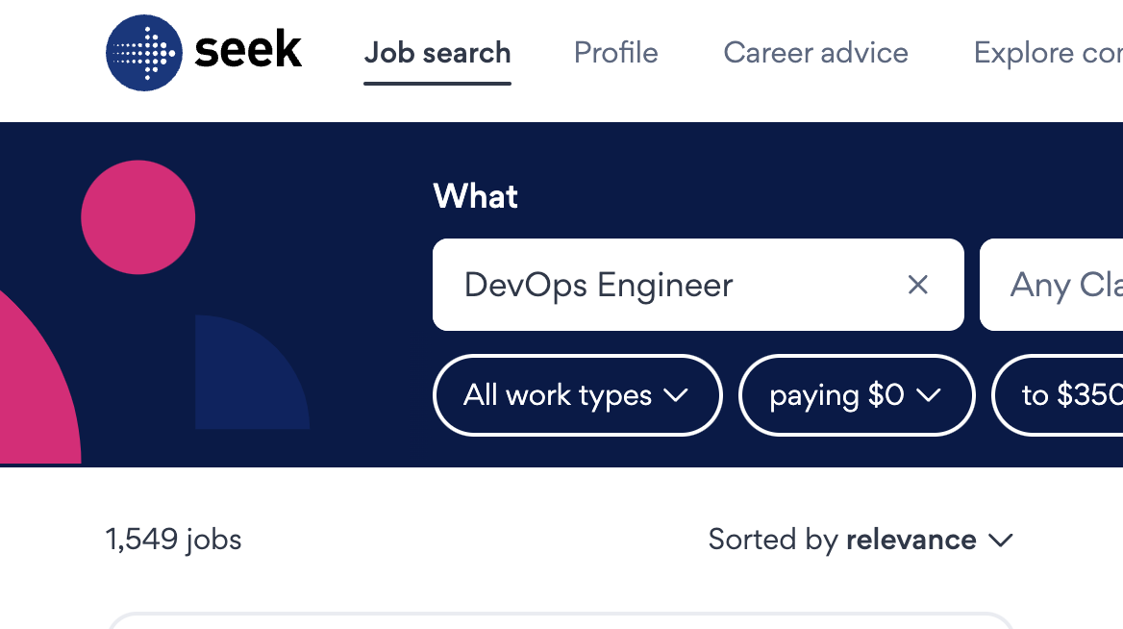
DevOps Engineer
A job title for programmers who focus on the infrastructure for deployment, testing, rollback, failover, etc
Title more common in cloud-delivery
(note: Azure DevOps is a product, skewing analysis)
Strong scripting capabilities
Understanding of security and networking
Cloud-native skills AWS/Azure
Related:
Site Reliability Engineer
Security DevOps (DevSecOps)

Slide 15
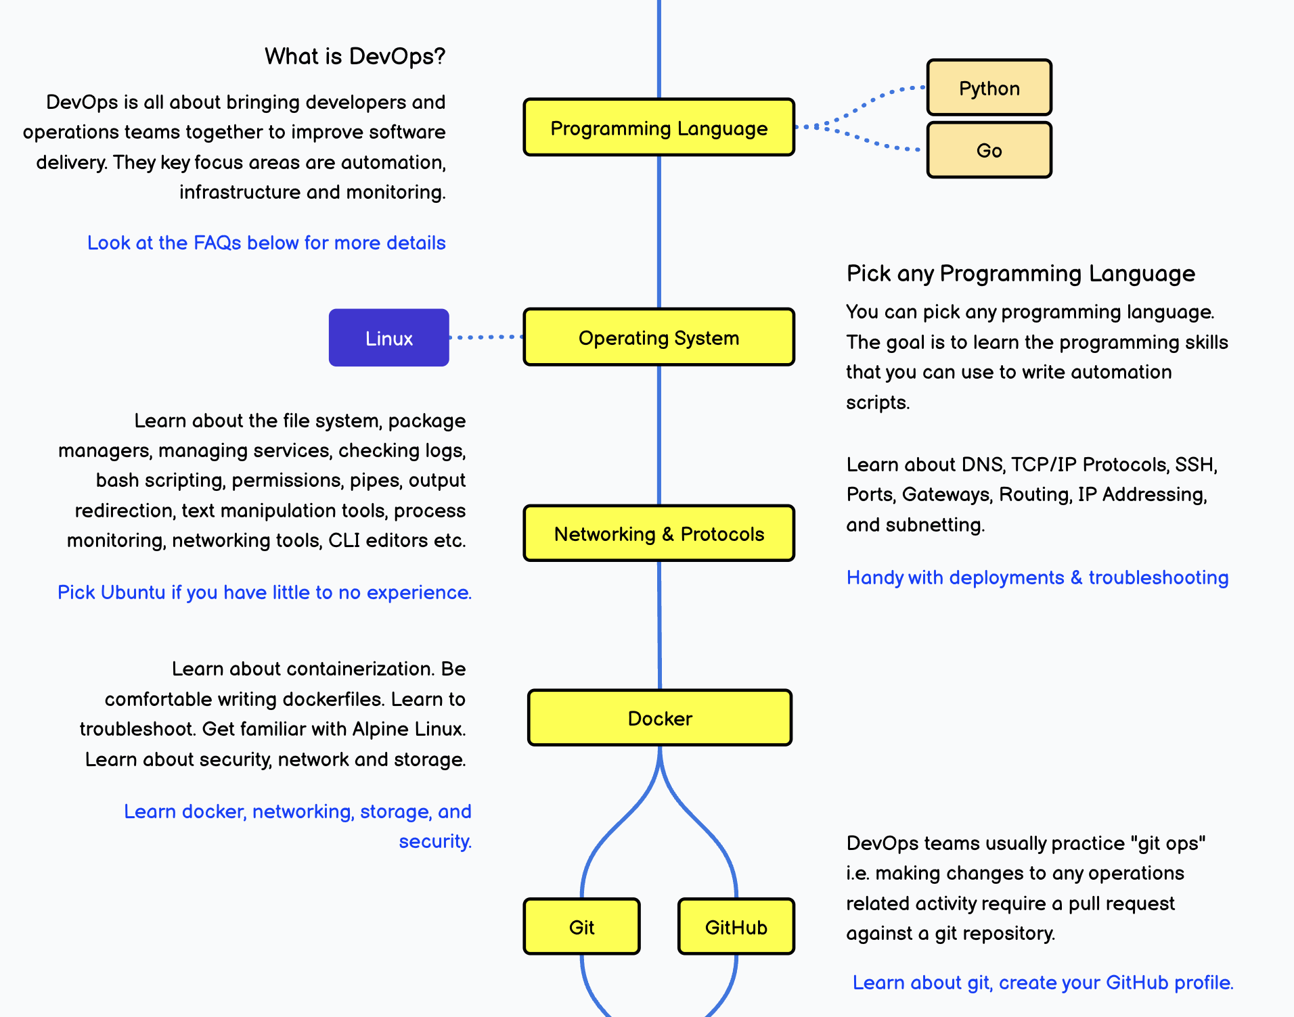
More information
https://roadmap.sh/devops?r=devops-beginner

Slide 16
Key concepts to emerge from DevOps
CI – Continuous Integration
Merging developers’ work into the “mainline” often
Sometimes several times a day
CD – Continuous Delivery
Ensuring code is always deployable and frequently deployed

Slide 17
CI
Relies on modern version control systems
Automated testing
Immediate feedback to developers
Advantages:
Detect bugs early
Reduce integration problems
Latest and greatest
Disadvantages:
Requires more “chores”
Additional technical challenges

Slide 18
CD
Automation:
automated provisioning
Environment parity:
ensuring analogues of the production environment are available early in dev → testing → staging → production
Feature toggling:
managing feature releases without deploying new code
CD requires CI CI does not require CD

Slide 19
CD: Concepts and Tools
Infrastructure as Code (IaC)
Configuration Management
Orchestration:
Coordinating automated tasks and workflows across multiple systems.
Monitoring and Logging:
Real-time data collection and analysis to inform decisions on performance and stability.
Rollback Strategies

Slide 20
GitHub as a DevOps Lifecycle Tool
GitHub Actions:
Automate workflows
Packages:
Host and manage packages alongside code
Security:
Automated scanning of code, alerts
Projects and Wikis
Webhooks and APIs:
3rd Party Integration (“marketplace”)
And internal integration

Slide 21
GitHub Actions for CI/CD
Automated Workflows:
Build, test, and validate code on events.
Customizable Pipelines:
Configure jobs to run in sequence or parallel
Hosted Runners:
Use GitHub-hosted runners to execute workflows in a clean environment.
Matrix Builds:
Test across multiple operating systems, programming languages, or application configurations simultaneously.
Hosting “secrets”

Slide 22
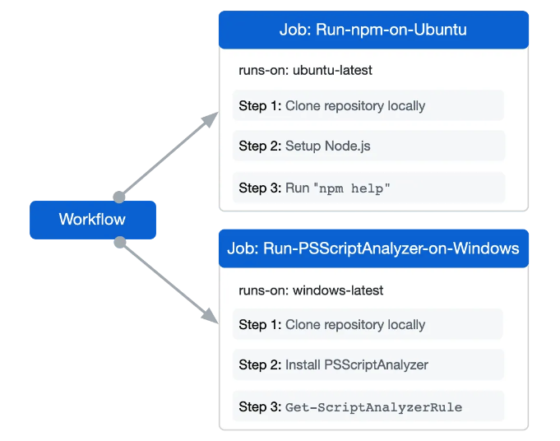
Using a GitHub-hosted runner
Notes:
https://docs.github.com/en/actions/using-github-hosted-runners/about-github-hosted-runners/about-github-hosted-runners

Slide 23
